Slide 1
Python Pandas - Advanced

Slide 2
Agenda
Concatenate Series and Dataframe
Join the Dataframes

Slide 3
Concatenate a Series

Slide 4
Concatenate a series
Creates a new series by appending a series with another series
The concat() and append() methods are used to concatenate a series
One can concatenate more than two series

Slide 5
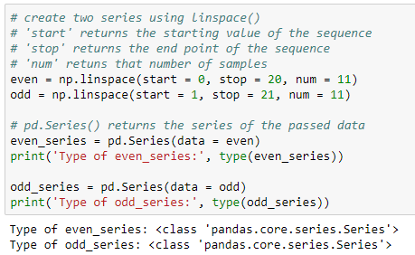
Create a series
Create python series as shown below:

Slide 6
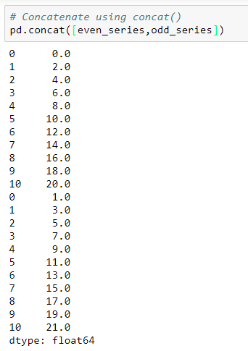
Concatenate a series
The concat() method concatenates a series in the order they are passed in the function

Slide 7
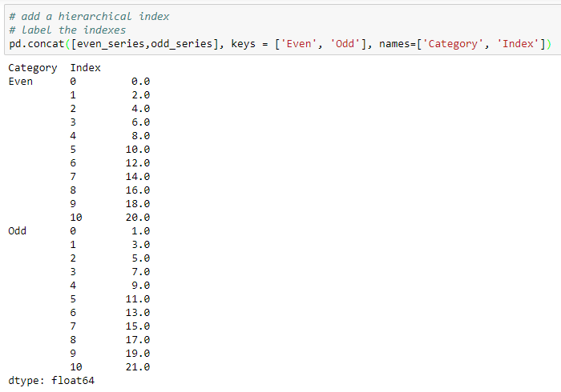
Add hierarchical index and label the index
Add the hierarchical indexes and labels while concatenating two series
Returns the hierarchical indexes
Returns the label of indexes

Slide 8
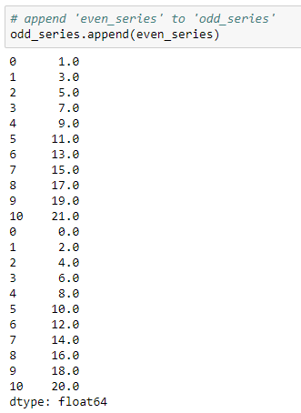
Concatenate a series
The append() method is used append a series with another
Here, we append the ‘even_series’ to ‘odd_series’
Appended indexes are same as the original series

Slide 9
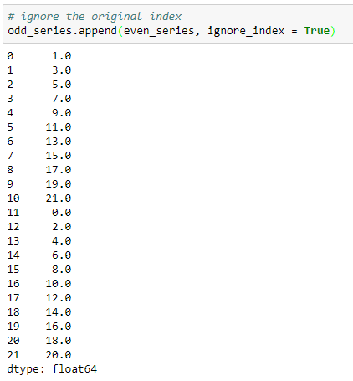
Concatenate a series
Ignores the index labels of original series

Slide 10
Concatenate the DataFrames

Slide 11
Concatenate the DataFrames
A Pandas DataFrame is a two dimensional size-mutable, heterogeneous data structure with labeled rows and columns
DataFrames can be concatenated vertically (column-wise) and horizontally (row-wise)
The concat() and append() methods are used to concatenate the DataFrames

Slide 12
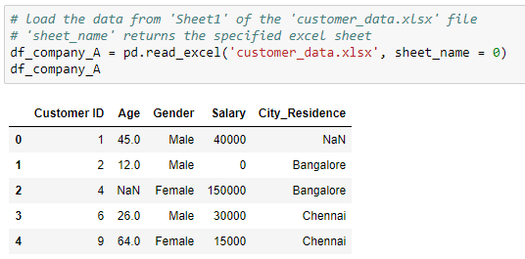
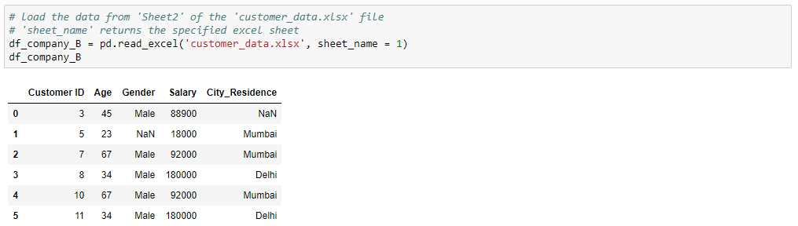
Read the DataFrames
Use these DataFrames for further manipulations:
Customer details of company A
Customer details of company B

Slide 13
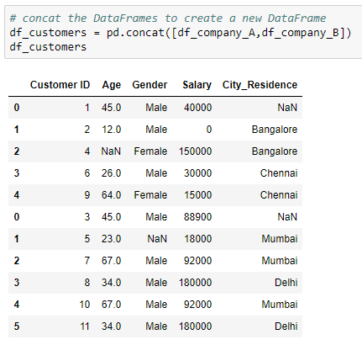
Concatenate the DataFrames
Two DataFrames are concatenated using concat() method
By default, the concat() method concatenates along the axis = 0 (vertically)
The concatenation is in the order they are passed in the function
The index numbers of the concatenated DataFrame are of the actual DataFrames

Slide 14

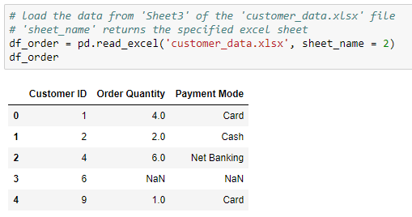
Read the DataFrames
The DataFrames contains order data for customers of company ‘A’. Use these DataFrames for further manipulations:
Customer details
Order details

Slide 15
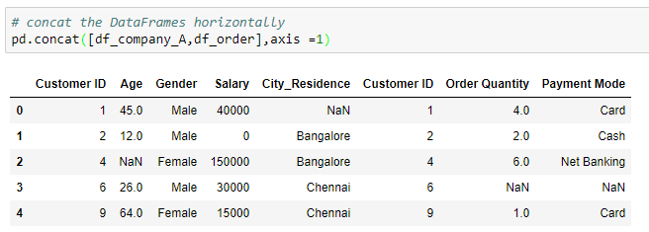
Concatenate the DataFrames
The parameter, ‘axis = 1’ concatenates the DataFrames horizontally
The concatenation is in the order they are passed in the function
As, we do not have the order details for ‘Customer ID = 6’, the NaNs are printed for corresponding columns

Slide 16
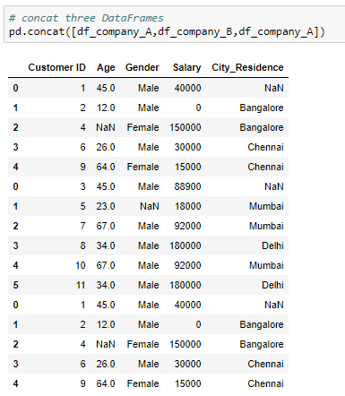
Concatenate multiple DataFrames
The concat() method can be used to concatenate more than two DataFrames simultaneously

Slide 17
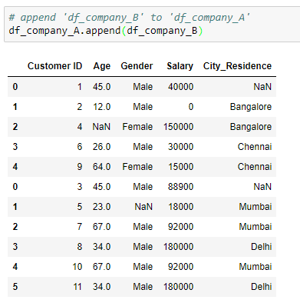
Concatenate the DataFrames
The append() method is used append a DataFrame with another
Here, we append the customers data of company ‘B’ to data of company ‘A’

Slide 18
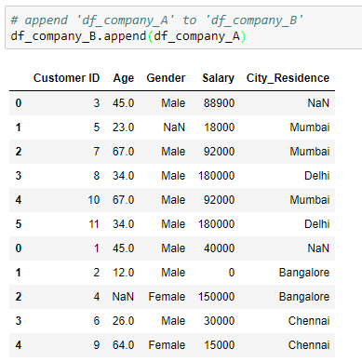
Concatenate the DataFrames
Here, we append the customers data of company ‘A’ to data of company ‘B’

Slide 19
Append vs. Concat
append() | concat()
returns the error if one tries to concatenate more than two DataFrames simultaneously | concatenates multiple DataFrames simultaneously

Slide 20
Join the DataFrames

Slide 21
Join the DataFrames
The join() method join the DataFrames based on index or key column
Index of the first DataFrame should match to one of the column in the second DataFrame

Slide 22
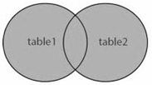
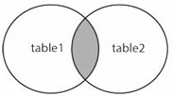
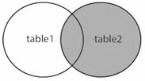
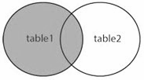
Types of join
The join types can be specified using the parameter, ‘how’
how = ‘Type’ | Description
outer | Use union of index (or column) observed in both DataFrames
inner | Use intersection of index (or column) observed in both DataFrames
right | Use only the index found in the right DataFrame
left | Use only the index (or column) found in the left DataFrame
If the type is not specified, by default it is ‘left’

Slide 23
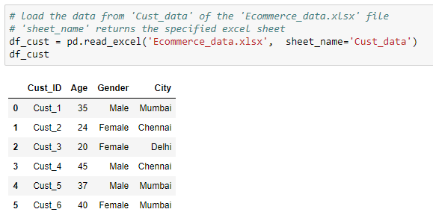
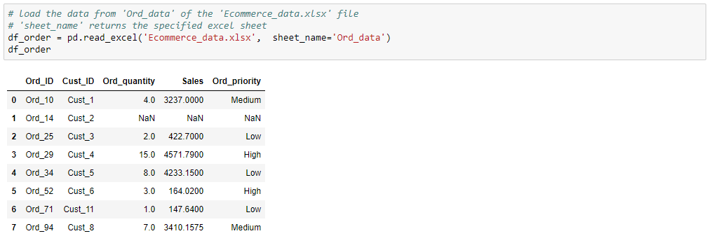
Read the DataFrames
Use the following DataFrames for further manipulations:
Customer details
Order details

Slide 24
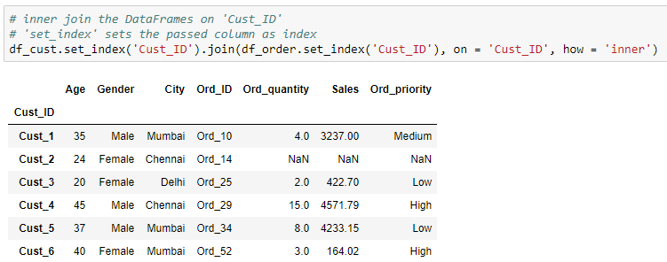
Inner Join
Join the DataFrames to get the order details along with the customer information
Merge includes the common IDs in both the DataFrames
‘Cust_ID’ as index of the new DataFrame
Merge on ‘Cust_ID’

Slide 25
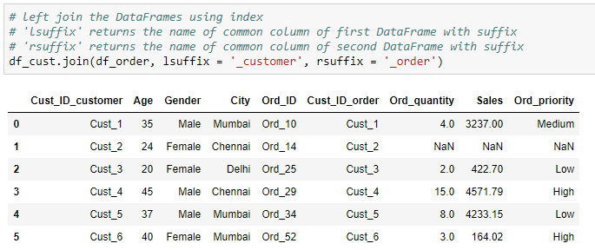
Join using index
Resultant DataFrame includes rows from both the DataFrames with same index as of ‘df_cust’
This method is useful, only if the record have same index in both the DataFrames

Slide 26
Unstack and Stack a Series

Slide 27
Create a series
Create python series as shown below:

Slide 28
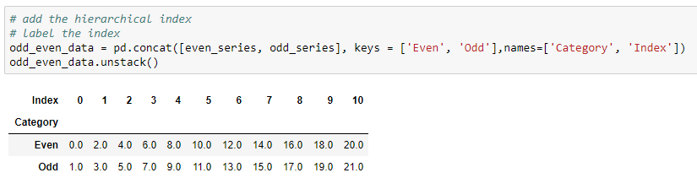
Unstack a series
Unstacking can be used to rearrange the series with hierarchical index in a DataFrame
Unstack the series at index ‘Index’

Slide 29
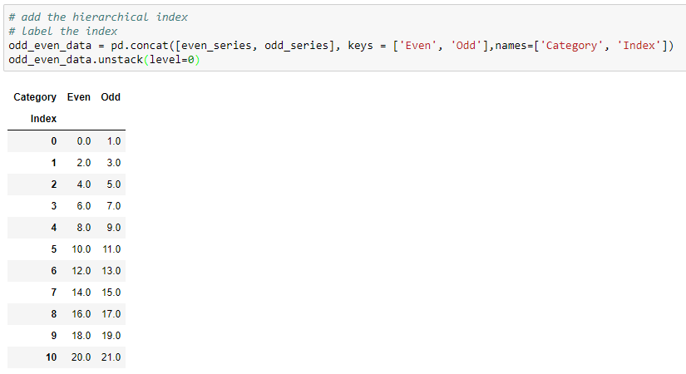
Unstack a series
We can pass the level of index to unstack the series using parameter, ‘level’
Unstack the series at index ‘Category’
By default, the unstack() method uses the last level of index (-1) to unstack the series

Slide 30
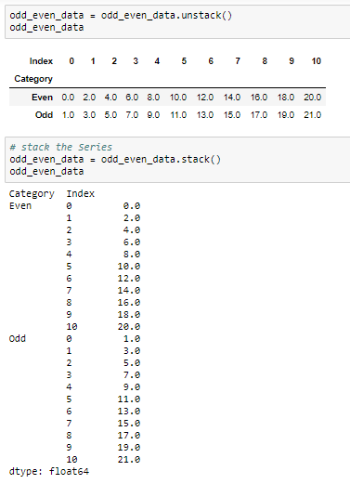
Stack a series
Stack is the inverse operation of unstack
It returns a series with hierarchical index

Slide 31
Unstack and Stack the DataFrame

Slide 32
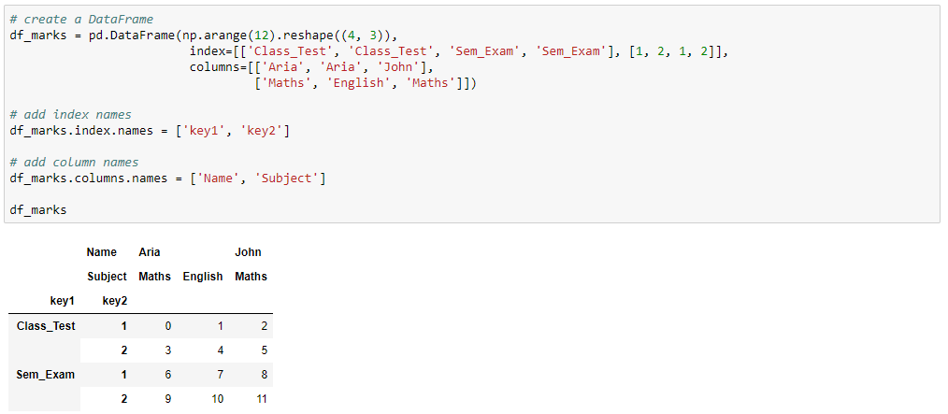
Create the DataFrame
Add the hierarchical indexes

Slide 33
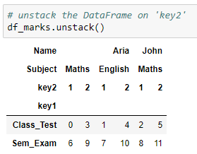
Unstack the DataFrame
Unstacking a DataFrame returns a DataFrame having a new level of column label which consists of the pivoted index label
New level of column
Unstack the DataFrame at index ‘key2’

Slide 34
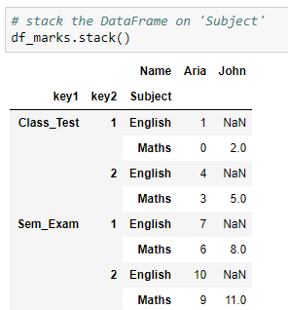
Stack the DataFrame
Stacking a DataFrame returns a DataFrame having a new level of innermost index consisting of the the pivoted column label
As the English marks for John are unknown, the NaNs are printed for corresponding observations
New level of
index

